Slide 1
Annual General Meeting

Slide 2
Welcome

Slide 3
Land Acknowledgement
We acknowledge that the office of the BC College of Social Workers is located on the traditional, ancestral and unceded territory of the xʷməθkʷəy̓əm (Musqueam people).
Further, this acknowledgment, gratitude and respect extends to all the First Nations communities on whose traditional territories the British Columbia College of Social Workers builds relationships and conducts business.

Slide 4
2020 Virtual Annual General Meeting A Review of the year 2019 Expected timeframe of meeting, 60 – 90 minutes Please use Chat Function for Questions and Comments. This presentation is being recorded.

Slide 5
British Columbia College of Social Workers Mandate As a regulatory body for Social Workers in British Columbia, the College acts within its statutory authority to develop and administer policies, procedures and practices that reflect the mandate of the College, which is, to protect the public from preventable harm by superintending the practice of social work in British Columbia.

Slide 6
Questions and Comments
Please use the Chat function to submit questions and make comments. A record of the questions and comments will be generated, and the information will be analyzed and utilized to inform both College processes and Strategic Planning Initiatives.

Slide 7
Chat Engagement Throughout the meeting we will be pausing to engage with participants by using the Webinar chat function. 1. In your controls at the bottom of the window, click or tap Chat. 2. When you click on Chat, the Chat window will appear. It will be on the right side of your screen if you are not in full screen. If you are in full screen, it will appear in a window that you can move around the screen. 3. Type your message and press enter to send it.

Slide 8
Chat Engagement Using the Chat function, type and send, From what location are joining this virtual Annual General Meeting?

Slide 9
Meeting Agenda
Quorum
Approve Draft Agenda
Approve minutes and present record of the 2019 Annual General Meeting proceedings
Report of the Chair
Report of the Registrar
Committee Reports
Registration Committee
Inquiry Committee
Discipline Committee
Registration Appeals Committee
Quality Assurance Committee
Policy Committee
Indigenous Committee
Finance Committee
Questions and Comment Acknowledgement
Close

Slide 10
Last Year’s 2019 Annual General Meeting Record of Proceedings
The video and documents associated with the 2019
Annual General Meeting can be found the following location:
https://www.bccsw.ca/about-us/annual-reports/
2018 Annual Report
2018 Annual General Meeting Slide Presentation
2019 Annual General Meeting Video

Slide 11
BC College of Social Workers 2019 Annual Report A copy of the BC College of Social Workers 2019 Annual Report can be found on the College’s website at the following location: https://www.bccsw.ca/about-us/annual-reports/

Slide 12
Chat Engagement Using the Chat function, type and send, What is the Social Work Practice Speciality that best describes the majority of your work?

Slide 13
2019 BCCSW Board of Directors
Chair- James (Jim) Campbell, RCSW
Vice Chair – Cheney Cloke, Public Member
SOCIAL WORK MEMBERS
Sonia Andi Bilkhu, RSW
Chelsea Minhas, RSW
Connie Kaweesi, RCSW
Ruth Kenny, RSW
Jenny Morgan, RSW
Christina Rodrigues, RSW
Sandra Wilson, RSW
PUBLIC MEMBERS
Denese Espeut-Post, LLB
Alisa Gloag
Natalie Shorten

Slide 14
2019 BCCSW Staff
Selena Bateman, RSW
Sheila Begg, RSW
Joan Braun, RSW
Ellice Daniel, RSW
Mark Hillenbrand, RCSW
Hoon Kim, JD
Madelaine Kirk, JD
Taylor Neufeld
Rosa Sackey, BA
Tracy Singh, BA-Candidate
Navid Tehrani, BS
Darren Usher, RSW

Slide 15
Report from the Chair
Presenter: James (Jim) Campbell, RCSW, Chair
2019 Highlights
2019 Year in Review
Reconciliation and Indigenous
Stakeholder Relations
Enhancing Public Safety
Enhancing Social Work Practice
Strengthening College Capacity

Slide 16
Report from the Registrar
Presenter: Mark Hillenbrand, RCSW, Registrar CEO
2019 Highlights
2019 Year in Review
Increased numbers of Social Workers applying to the College for Registration.
Quality Assurance Committee
Registration Committee
Inquiry Committee
Indigenous Committee
Policy Committee
Finance Committee
Operational Update

Slide 17
Registration Committee
New Registrations, 2019
Full (RSW) | 327
Clinical (RCSW) | 16
Non-practising | 1
Provisional | 16
Temporary | 5
Total new registrants | 365
Presenter: Connie Kaweesi, RCSW
2019 Committee Members:
Chair – Connie Kaweesi, RCSW
Stephanie Mortenson, RSW
Allison Mounsey, RSW
Hardeep Mann, RSW
Hanna Scrivens, RSW
Total Registrants by Category on December 31, 2019
 | Full (RSW) | 4328
 | Clinical (RCSW) | 195
 | Non-practising | 471
 | Provisional | 5
 | Temporary | 3
Total registrants |  | 5002

Slide 18
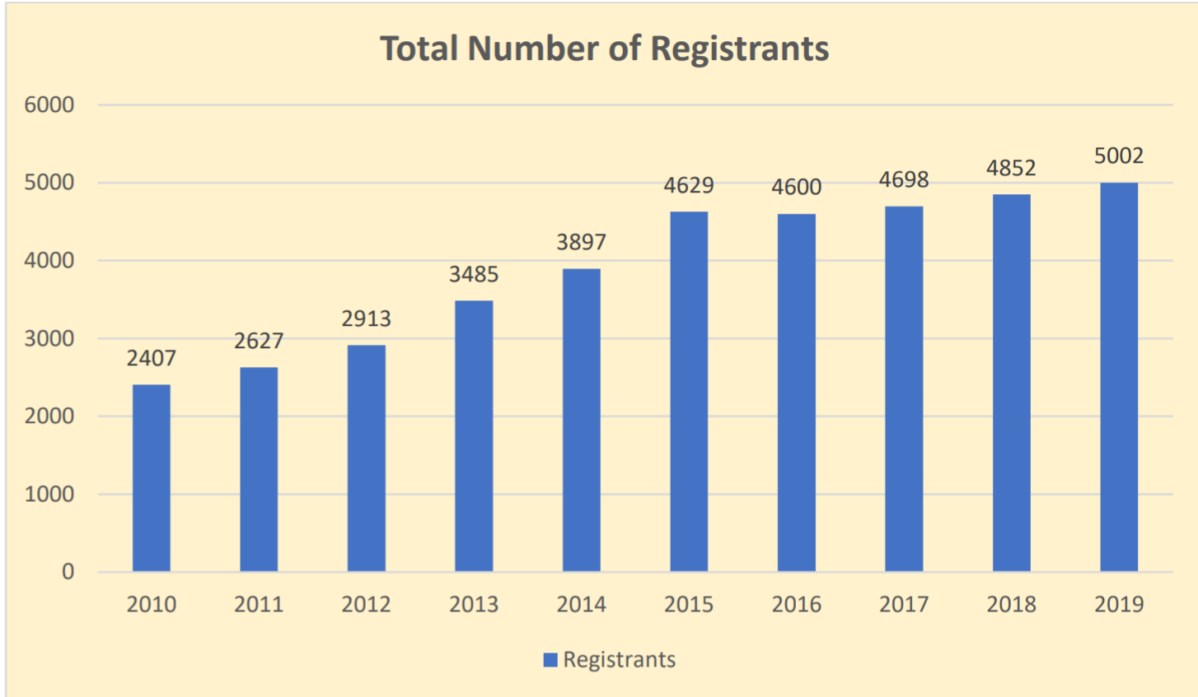
BCCSW 2010 – 2019 Number of Registrants

Slide 19
Chat Engagement Using the Chat function, type and send, What is a component of the College’s work that you believe the College is doing quite well?

Slide 20
Inquiry Committee
The Inquiry Committee is established by the Social Workers Act for the purpose of receiving and investigating complaints about registrants in adherence to the duties and objectives of the College in protecting the public.
In 2019, the College opened 28 Inquiry Files. This number represents an increase of 115% over the number of complaints, 13, that were opened in 2018.
Presenter: Christina Rodrigues
2019 Committee Members:
Chair – Chelsea Minhas, RSW
Shannon Bender-Bell, RCSW
Denese Espeut-Post, Public Appointee
Denise Moleschi, RSW
Christina Rodrigues, RSW

Slide 21
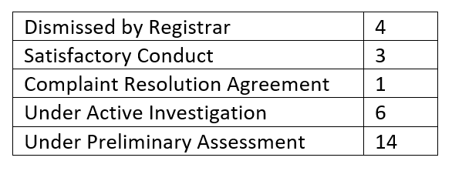
Inquiry Committee
Inquiry Files Opened in 2019
Misconduct: Conduct occurring during the course of practicing social work.
Conduct Unbecoming: Conduct occurring outside of the course of practice which is so egregious it could harm the public’s trust in the profession or otherwise bring the profession into disrepute.
Competence: Registrant’s physical and mental competence to practice.
Category

Slide 22
Discipline Committee
No citations were issued during 2019
2019 Committee Members:
Chair – Alisa Gloag, Public Appointee
Sonia Andhi Bilkhu, RSW
Arpna Bhullar, RSW
Amenda Kumar, RSW
Craig Norris, RCSW

Slide 23
Registration Appeals Committee
No requests for review were brought forward during 2019
2019 Committee Members:
Chair – Chelsea Minhas, RSW
Alisa Gloag, Public Appointee
Traci Marriott, RSW
Vinita Puri, RSW
Alison Van Schie, RSW

Slide 24
Quality Assurance Committee
The Quality Assurance Committee continued the ongoing project of updating and revising the College’s standards of practice. The results of the public consultation process and current Standards of Practice draft revisions have been posted the College website.
The Quality Assurance Committee reviewed Continuing Professional Development (CPD) program and established ongoing action items to assess and evaluate CPD expectations and processes.
Presenter: Antoine Coulombe, RSW
2019 Committee Members:
Chair – Emma Gauvin, RSW
Lorry-Ann Austin, RSW
Antoine Coulombe, RSW
Connie Kaweesi, RCSW
Natalie Lachance, RSW
David Lemire, RSW
Four Continuing Professional Development waiver requests were received and granted for the 2018-2019 CPD hour cycle.
Of the total number of Registrants on October 31, 2019, 88.4 %, of those Registrants submitted CPD hours on time prior to submittal deadline of October 31st.

Slide 25
Policy Committee
Presenter: James (Jim) Campbell
2019 Committee Members:
Chair – James (Jim) Campbell, RCSW
Sonia Andhi Bilkhu, RSW
Connie Kaweesi, RCSW
Chelsea Minhas, RSW
Jenny Morgan, RSW
Christina Rodrigues, RSW

Slide 26
Chat Engagement Using the Chat function, type and send, What is a component of the College’s work that you believe could be done better?

Slide 27
Indigenous Committee
Presenter: Ruth Kenny
2019 Committee Members:
Chair – Ruth Kenny, RSW
Cheney Cloke, Public Appointee
Jennifer-Lee Koble, RSW
Jenny Morgan, RSW
Wendy Simon, RSW
Sandra Wilson, RSW

Slide 28
Indigenous Committee
The Indigenous Committee continued to revise and refine their terms of reference and implement key recommendations from:
The Nashwito Creek & Associates final report
Truth and Reconciliation Commission
United Nations Declaration on the Rights of Indigenous Peoples
Missing and Murdered Indigenous Women and Girls
The Royal Commission on Aboriginal Peoples of Canada.
Implementation of the key recommendations will assist the College in meeting the goals of the College’s Towards Developing a Respectful Relationship Initiative (TDRR).

Slide 29
Indigenous Committee
The Indigenous Committee reviewed and refined the College’s acknowledgement of Indigenous Territories, as follows:
We acknowledge that the office of the British Columbia College of Social Workers is located on the traditional, ancestral and unceded territory of thexʷm əθkʷ əy̓əm(Musqueam people). Further, this acknowledgement, gratitude and respect extends to all the First Nations Communities on whose traditional territories the BC College of Social Workers builds relationships and conducts business.

Slide 30
Indigenous Committee
The Indigenous Committee engaged with Indigenous Social Work students and youth to participate and to share their voice, views, experiences and strength at Committee meetings.
Additionally, 2019 Indigenous Committee meetings included the presence of an Indigenous Elder.
The Indigenous Committee engaged in discussions with the Board and Registrar regarding options to increase Indigenous representation on College staff and the inclusion of an Indigenous Elder at all Board meetings.

Slide 31
Indigenous Committee
Indigenous Artist Bryce Williams from the Tsawwassen First Nation was contracted to design and create an Indigenous Committee logo. This new logo will become a key component of Indigenous Committee branding.
Indigenous Videographer Tricia Thomas of Salish Eye Productions was contracted to produce a video highlighting Indigenous Social Work and Indigenous Registered Social Workers.

Slide 32
Indigenous Committee
BCCSW Indigenous Committee Video Project 2019
in joint production with Tricia Thomas, Salish Eye Productions.

Slide 33
Chat Engagement Using the Chat function, type and send, From the perspective of professional regulation and the College’s mandate to protect the public from preventable harm by superintending the practice of social work in British Columbia, What improvement would you suggest that would positively impact your social work practice?

Slide 34
Finance Committee
Presenter: Cheney Cloke, Public Appointee
2019 Committee Members:
Chair – Denese Espeut-Post, Public Appointee
James (Jim) Campbell, RCSW
Cheney Cloke, Public Appointee
Sandra Wilson, RSW
The Finance Committee is responsible for:
Managing the Board’s system of Financial Administration Including:
Accounting practices and systems, including classification of accounts, internal control and auditing systems.
Financial planning.
Budgetary Control.
Ensuring the safekeeping of Board assets, including assets held in Trust.
Managing College revenues, including receipt, recording and control of funds and deposit to accounts maintained by the Board.

Slide 35
Finance Committee
In 2019 the BC College of Social Workers retained Reid Hurst Nagy, Inc., Chartered Professional Accountants to complete an audit of the College’s financial statements.
Reid Hurst Nagy, Inc., Chartered Professional Accounts, Independent Auditors Report on the Audit of the Financial Statements, page 1, paragraph 2, (2019)
“In our opinion, the accompanying financial statements present fairly, in all material respects, the financial position of the College as at December 31, 2019 and its financial performance and its cash flows for the year then ended in accordance with Canadian accounting standards for not-for-profit organizations.”

Slide 36
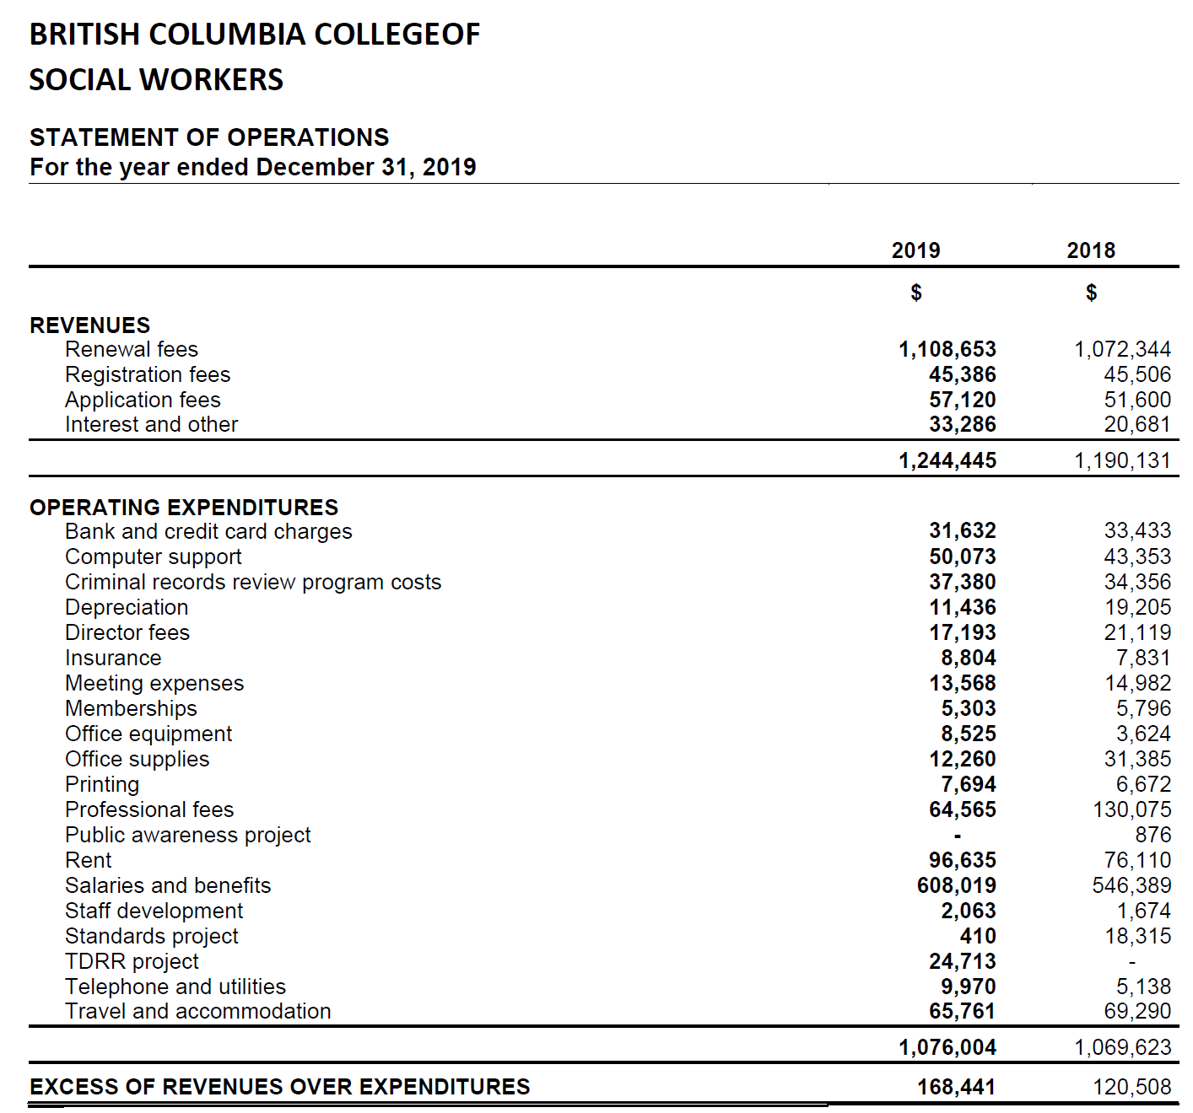
Finance Committee
Complete Financial Audit Report is included in 2019 Annual Report and is available on College website.

Slide 37
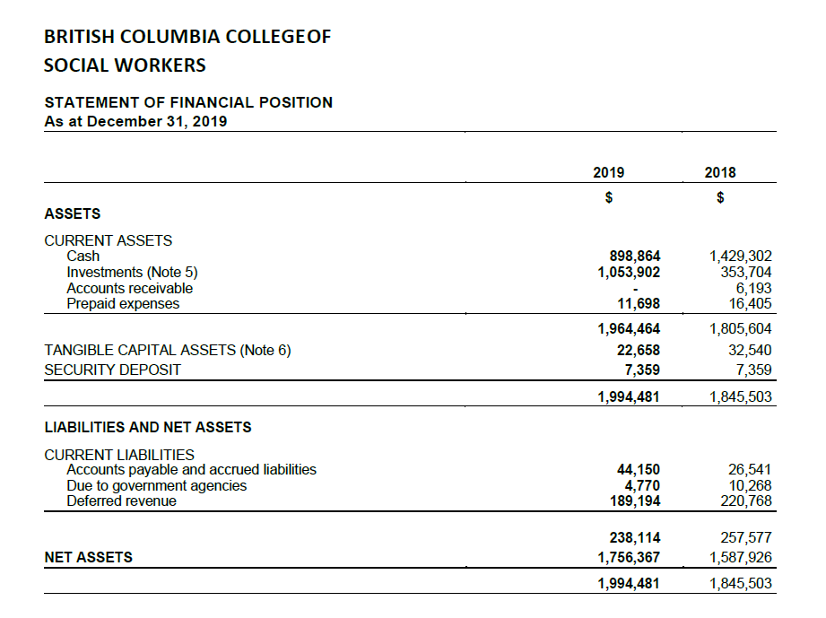
Finance Committee
Complete Financial Audit Report is included in 2019 Annual Report and is available on College website.

Slide 38
Chat Engagement Using the Chat function, type and send, The College is currently engaged in a strategic planning process, What significant issue do you see the College facing in the near future?

Slide 39
Questions and Comments
Please use the Chat function to submit questions and make comments. A record of the questions and comments will be generated, and the information will be analyzed and utilized to inform both College processes and Strategic Planning Initiatives.

Slide 40
Thank you
Additional comments and feedback can be emailed to info@bccsw.ca

